Slide 1
Computer Architecture
Lectorial Week 5

Slide 2
Objectives
Looking at last week’s reinforcement exercises
Improving the machine
Little Man Computer (LMC)
Making links
Looking forward
Moving from LMC to MIPS architecture

Slide 3
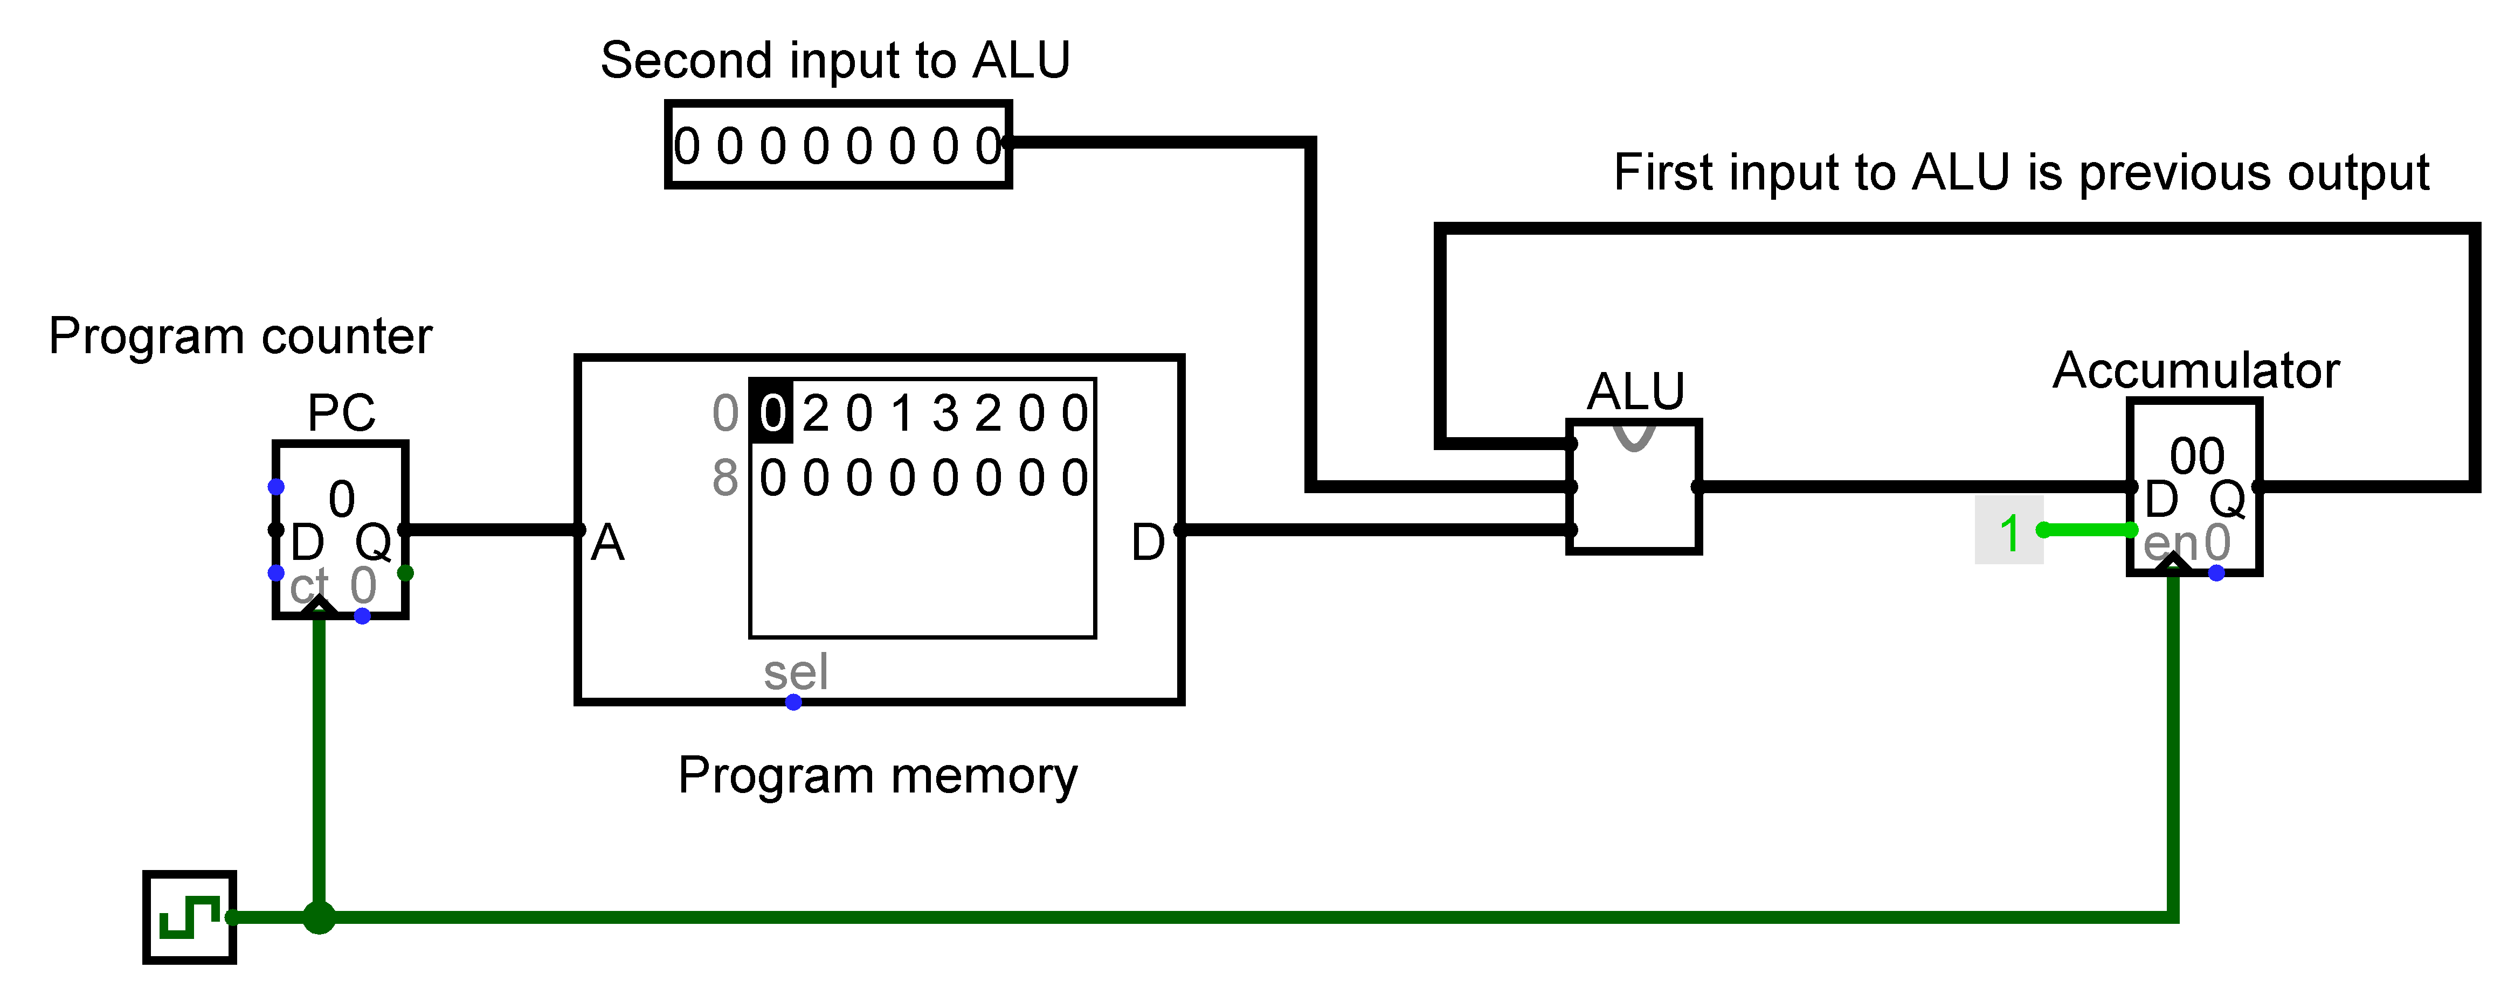
Improving the machine
The “computer” developed in the lab sessions had many limitations

Slide 4
Extending the operations
The instructions will now be 16 bits containing
The operation for the ALU and the second input to the ALU (when needed)
15 | 14 | 13 | 12 | 11 | 10 | 9 | 8 | 7 | 6 | 5 | 4 | 3 | 2 | 1 | 0
ALU operation |  | Unused (00) |  | Unused (0000) |  |  |  | Immediate value to use as input
Hex digit |  |  |  | Hex digit |  |  |  | Hex digit |  |  |  | Hex digit
ALU operation
-
Operation
ALU operation
-
New format
Hex
decimal
description
binary
0
Add
00
0000
0
1
AND
01
0100
4
2
Subtract 1
10
1000
8
3
Left shift
11
1100
c

Slide 5
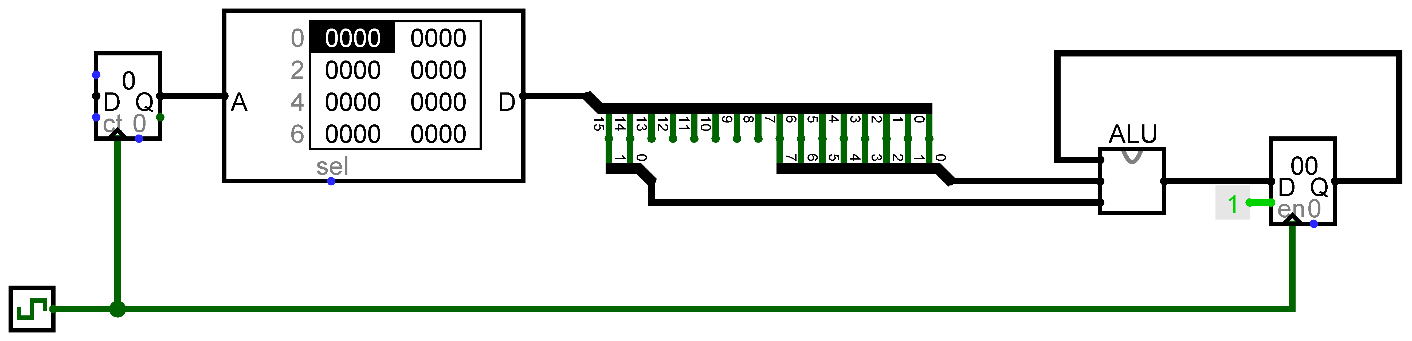
New version of the CPU
The ROM now holds 16 bits at each address

Slide 6
Preparing the program
Working out the AND
Decimal 27 is binary 0001 1011
Decimal 60 is binary 0011 1100
After a bitwise AND 0001 1000
The ROM and accumulator show the data in hex but some parts might be easier to work out in binary
Program
Operation
Instruction in binary
Instruction
Expected
Expected
counter
(decimal)
in hex
value in
value in
accumulator
accumulator
(binary)
(hex)
0
Add 27
0000 0000 0001 1011
001b
0001 1011
1b
1
AND with 60
0100 0000 0011 1100
403c
0001 1000
18
2
Subtract 1
1000 0000 0000 0000
8000
0001 0111
17
3
Left shift
1100 0000 0000 0000
c000
0010 1110
2e

Slide 7
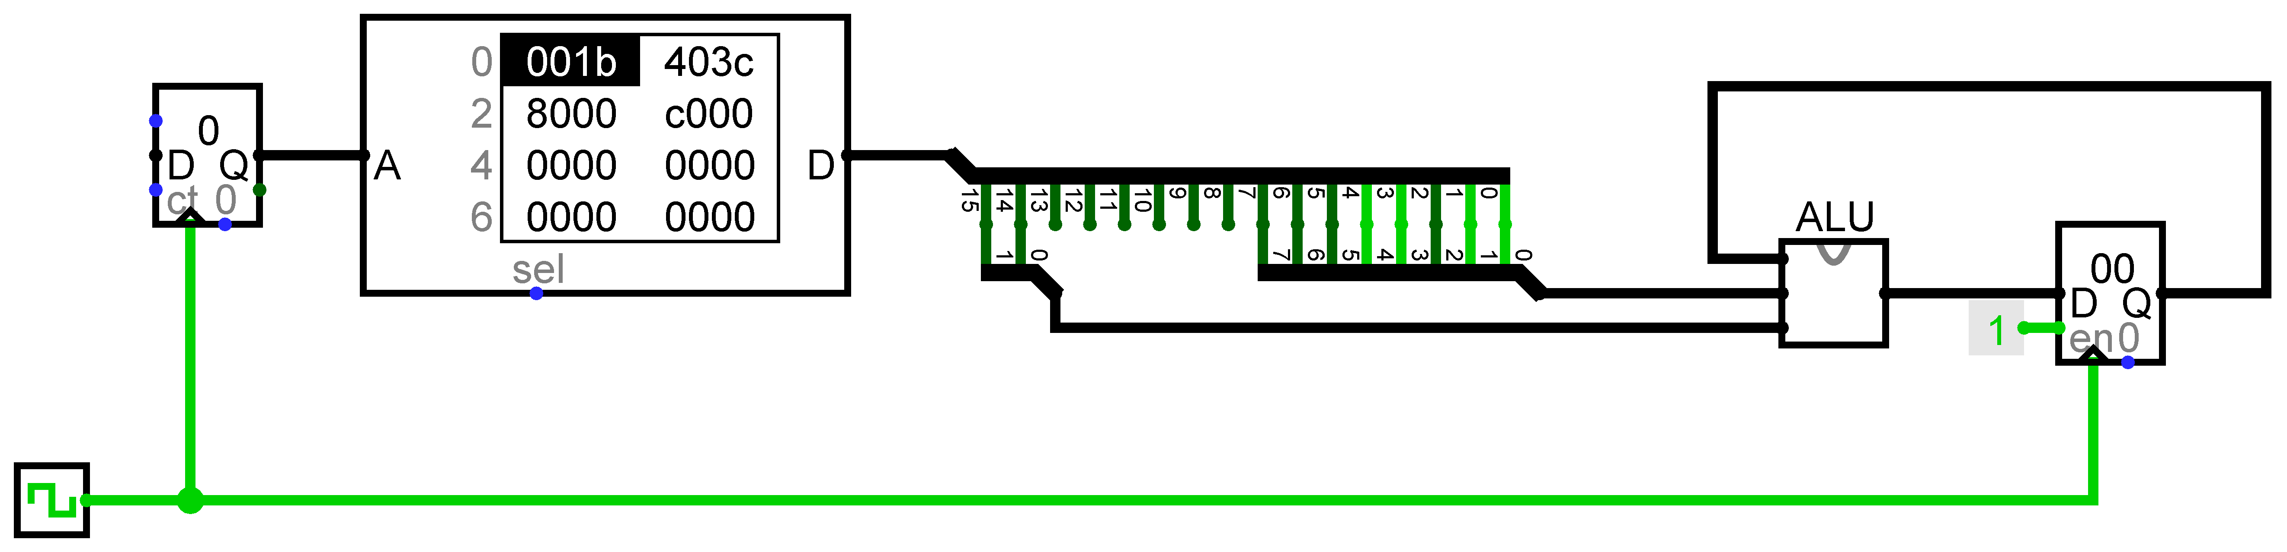
Running the program
One instruction will run each time the clock goes to 1

Slide 8
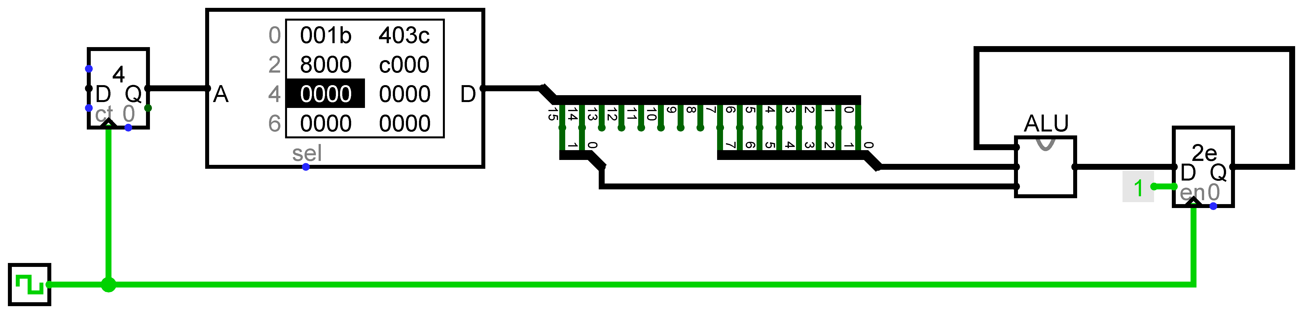
Running the program
End of simulation when all the instructions have been run

Slide 9
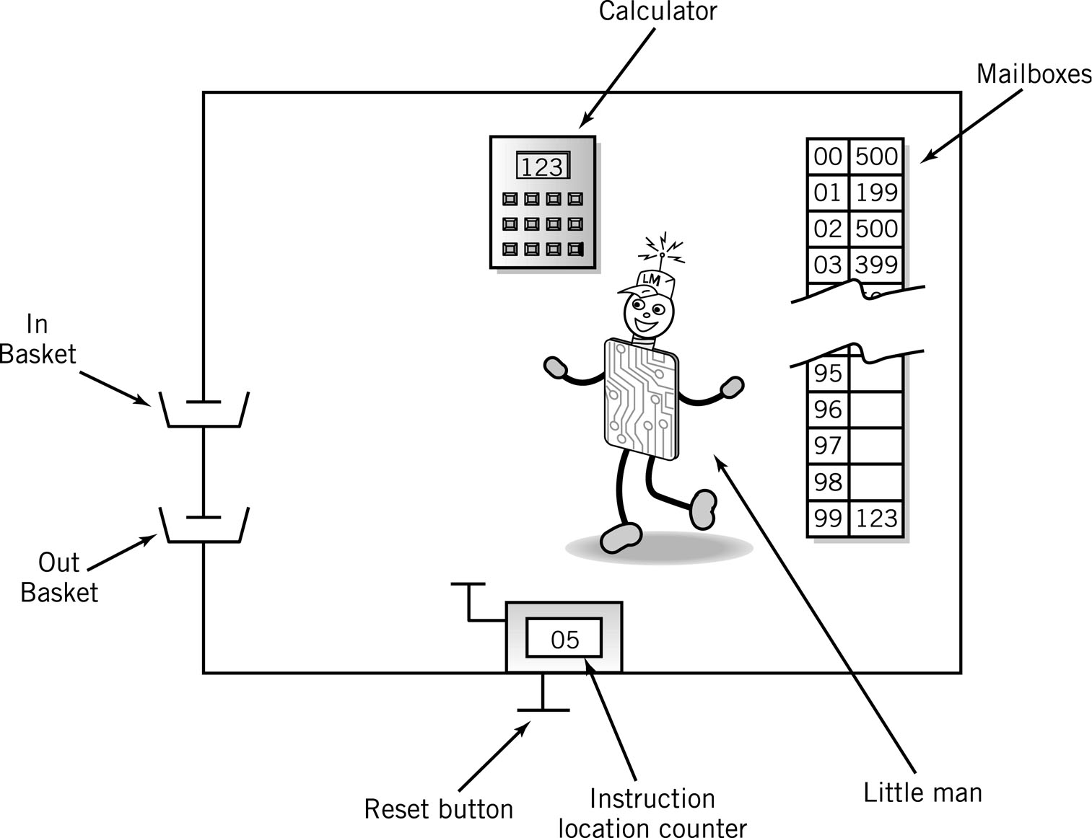
Little Man Computer

Slide 10
Little man computer
Mnemonic | Name | Op Code
INP | INPUT | 901
OUT | OUTPUT | 902
LDA | LOAD | 5xx
STA | STORE | 3xx
ADD | ADD | 1xx
SUB | SUBTRACT | 2xx
BRP | BRANCH IF POSITIVE | 8xx
BRZ | BRANCH IF ZERO | 7xx
BRA | BRANCH ALWAYS | 6xx
HLT | HALT | 000
DAT | DATA LOCATION
Machine code
The numeric format of instructions to be loaded into the mailboxes to run
Instructions run one after another in order
… unless some special instructions alter this flow
Assembly language
Write program using mnemonics and symbols for human readability
We use labels (words) to represent mailbox numbers
Assembler
Program that converts Assembly language into machine code

Slide 11
Count down from input number to zero
Take the number form the input basket and store in the calculator display
INP
loop OUT
SUB one
BRP loop
HLT
one DAT 1
one is a label that relates to a memory address

Slide 12
Looking at computer architectures
With an introduction to MIPS architecture

Slide 13
Instruction Set
Each processor has its own instruction set
The full set of operations that have been built into the hardware by combining logic gates into circuits
As in the Little Man Computer and Logisim CPU simulations, instructions are given as structured numbers in machine code
There are many common features across different hardware
A program runs by carrying out a list of instructions on hardware
We are using MIPS
It’s relatively simple and has a simulator (MARS) for educational use to allow us to get a taste of Assembly language programming

Slide 14
CISC and RISC
RISC
Reduced instruction set computing
Hardware itself is quite simple, smaller instruction set
Several machine code instructions may be needed for a complex task
Each instruction takes a single clock cycle
CICS
Complex instruction set computing
Larger instruction set
Complex instructions available directly in the hardware
Single machine code instruction for complex operations, but may take multiple clock cycles

Slide 15
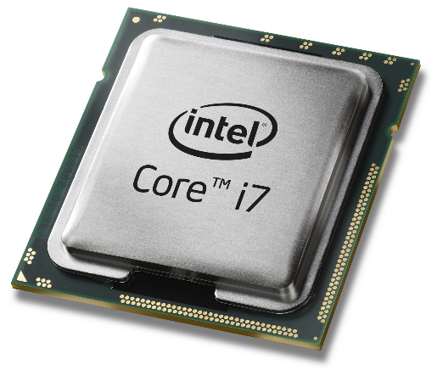
Intel x86 family
Started in 1978 with Intel 8086 (16-bit)
Currently on Core i9
Used in most Laptops, Desktops, and Servers
Backwards Compatible
Latest versions transitioned to x86-64 Instruction
CISC

Slide 16

ARM Processors
Originally for Personal Computers
Most common use in low power devices
Used in smart phones, Raspberry Pi
32 or 64 bit
RISC

Slide 17

IBM Z Series
CISC
Specialist hardware for business computing – particularly finance
Known as a mainframe

Slide 18
MIPS
RISC
Influenced other Architectures (ARM)
Used in Embedded Processor in Routers, etc
Used by many Computer Organization type courses
Used in this Course (MARS simulator)
Instruction set is typical of many modern ISAs

Slide 19
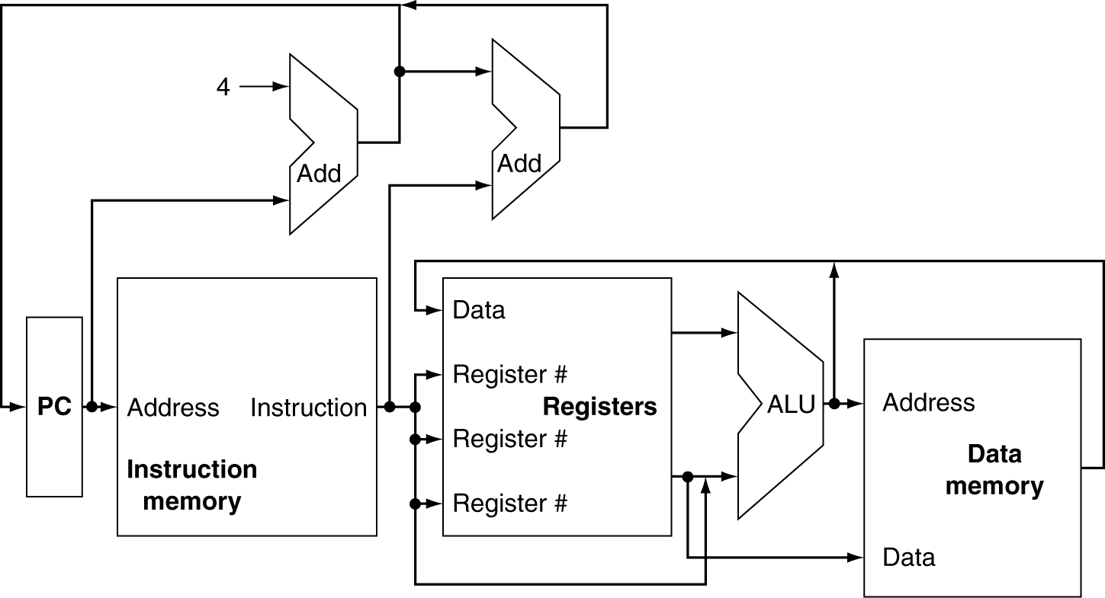
MIPS Architecture overview
Similar to coursework Logisim CPU
Arithmetic and Logic Unit (ALU)
Instruction Memory
Machine code
Data Memory
Memory shown separate for convenience only
Program Counter (PC)
Address of next instruction to execute

Slide 20
MIPS Architecture overview continued
Differences from coursework Logisim CPU
Registers
Fast temporary storage in CPU
MIPS has 32 registers each holding 32 bits
In MIPS, the ALU only takes input from registers (not from data memory)

Slide 21
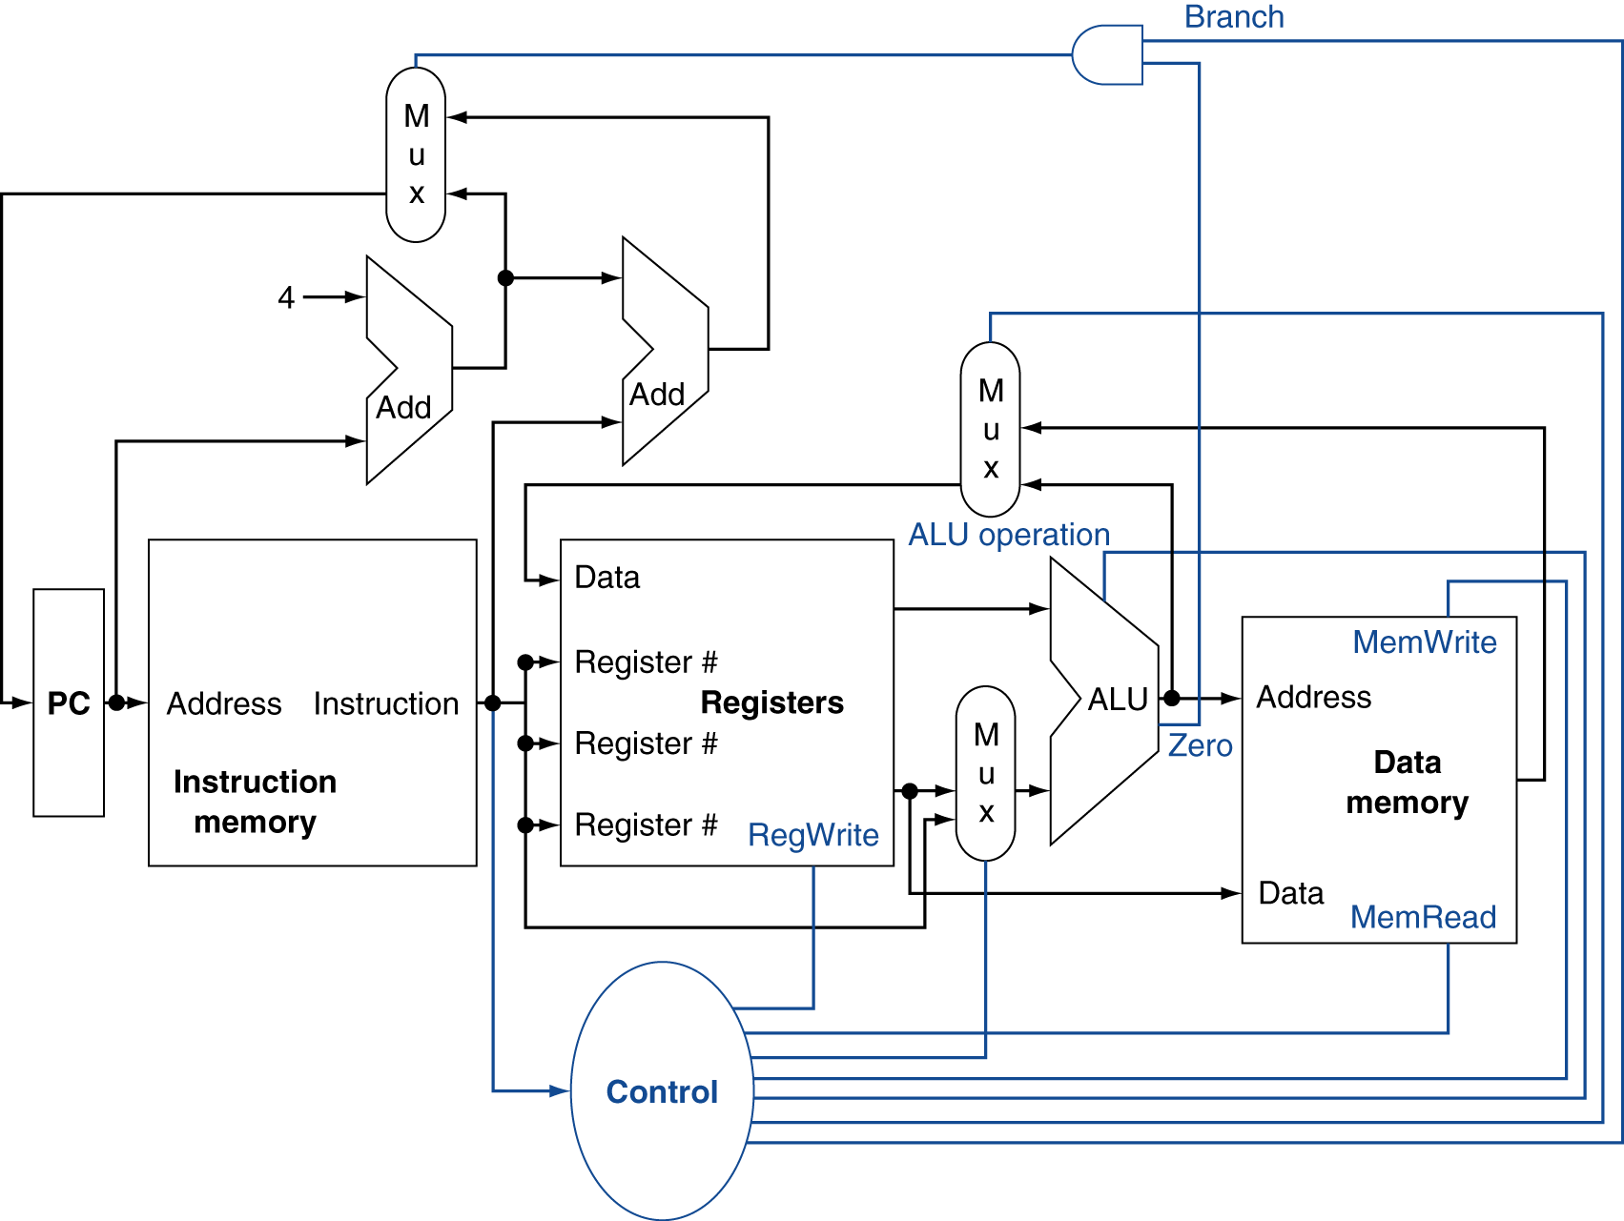
MIPS Control
Showing detail of how signals are combined and selected

Slide 22
MIPS Instructions
MIPS instructions are 32 bits
Different Instructions will use those 32 bits in different ways to specify different information
We will have a brief look at one instruction in machine code, but we will write our programs in MIPS assembly language

Slide 23
MIPS add instruction
op
rs
rt
rd
shamt
funct
6 bits
5 bits
5 bits
5 bits
5 bits
6 bits
add $t0, $s1, $s2
special
$s1
$s2
$t0
0
add
0
17
18
8
0
32
000000
10001
10010
01000
00000
100000
00000010001100100100000000100000₂ = 02324020₁₆

Slide 24
MIPS Assembly language
Assembly languages
Use mnemonics (short written forms of instruction)
Use human readable labels to identify memory locations
Needs to be assembled to convert to machine code
MIPS assembly language
Registers are referred to with a $
Basic instructions relate directly to the architecture of the hardware
Extended (pseudo) instructions are converted by the assembler into basic instructions

Slide 25
Assemblers
Machine code is binary and difficult for humans to read or write
An Assembler translates an Assembly language instruction into the equivalent binary machine code
add $t0, $s1, $s2
Assembly Code
00000010001100100100000000100000₂
Machine Code

Slide 26
Looking at an instruction
Instructions in assembly language have a regular format
First a mnemonic for the operation followed by parameters
Usually (but not always) the destination is next, then source
Operation
Operands (variables, arguments, etc.)
add $t0, $t1, $t2
Source Operands (input to the operation)
Destination Operand (where to store result)
Immediate Operand
addi $t0, $t1, 1

Slide 27
MIPS Registers
There are 32 registers
Each holds 32 bits
26 general registers, others have specific uses
Register names start with $ in MIPS Assembly language
The inputs to the ALU are registers
This means to operate on a variables in memory you must:
Load the value/values from memory into a register
Perform the instruction
Store the result back into memory
Going to and from memory can be expensive
(4x to 20x slower than operating on a register)

Slide 28
Summary
We will write programs in MIPS Assembly language
We use a small set of instructions
Arithmetic operations only act on registers
We have to assemble our programs to turn them into machine code to run them
We use labels to refer to memory addresses
We use the MARS MIPS Assembler and Runtime Simulator
Educational environment to simulate a MIPS processor
We use aspects of Assembly language that are common to many processors
The simulator allows us to see register contents and step through programs
Download from
https://courses.missouristate.edu/KenVollmar/mars/download.htm

